Slide 1
Chapter 9
Introduction to Statistical Inference

Slide 2
Outline
Student Learning Objectives
Key Terms
The Cars Data Set
The Sampling Distribution
Statistics
The Sampling Distribution
Theoretical Distributions of Observations
Sampling Distribution of Statistics
The Normal Approximation
Simulations
Self-Quiz Review

Slide 3
Student Learning Objectives
- Define key terms that are associated with inferential statistics.
- Recognize the variables of the “cars.csv" data frame.
- Revise concepts related to random variables, the sampling distribution
and the Central Limit Theorem.

Slide 4
Key Terms
A parameter: is a characteristic of a population.
A statistic: is a function of the data. It is a characteristic of a sampe.
Point estimation: attempts to obtain the best guess to the value of that parameter.
An estimator: is a statistic that produces the best guess to the value of the parameter.
A Confidence interval: is an interval that is most likely to contain the population parameter.
The confidence level: is the sampling probability that the confidence interval will indeed contain the parameter.
A hypothesis testing: refers to the formal procedures used by statisticians to accept or reject statistical hypotheses. A statistical hypothesis is an assumption about a population parameter. This assumption may or may not be true.

Slide 5
Key Terms
A test statistic: is used in a hypothesis test when you are deciding to support or reject the null hypothesis. It is a function of the sample data used to decide whether or not to reject the null hypothesis.
The significance level: also denoted as alpha or α, is the probability of rejecting the null hypothesis when it is true.
Regression: is an important tool for the investigation of the relations between two measurements, or variables. Models of regression describe the change in the distribution in one variable as a function of the other variable.
A response variable (or dependent variable): The variable whose distribution is the target of investigation in a regression model.
An explanatory variable (or independent variable): The other variable that may affect that distribution of the response variable in a regression model

Slide 6
Key Terms
Three problems that require statistical inference:
The estimation of a parameter:
Point estimation can be used to estimate a parameter
A confidence interval is another approach to estimate the parameter
Hypothesis testing: here hypothesis testing is used
Investigation of the relations between two measurements: here regression is used

Slide 7
The Cars Data Set
This is the dataset that will be used for all the procedures presented in Chapters 10-15
-You can use the R code below to read the cars dataset without having to download any files:
cars<-read.csv('http://pluto.huji.ac.il/~msby/StatThink/Datasets/cars.csv')

Slide 8
The Sampling Distribution

Slide 9
Statistics
Statistical inferences are based on statistics computed from the data.
Every tools (point estimation, confidence intervals, or testing hypothesis) used in statistical inference will then be based on statistics.
Example of statistics: sample average; sample standard deviation;the smallest or largest value of a dataset; quartiles, the median and the frequency of a factor.
Very important distinction:
When a statistic is computed in the context of the given data frame (or sample data), it is a single numerical value. In this case, the statistic will be represented by small letters.
When a statistic is computed in the context of the random sample (or collection of data frames or sampling distribution), the statistics is a random variable. In this case, the statistic will be represented by capital letters

Slide 10




Statistics
This formula gives the sample average. This statistic is a numerical values.
This formula gives the sample average. This statistic is a random variable since it is an average in the context of random sample.
This formula gives the sample variance. This statistic is a numerical values.
This formula gives the sample variance. This statistic is a random variable since it is an average in the context of random sample.

Slide 11
The Sampling Distribution
The sample distribution emerge from two ways:
As a random selection of samples from a particular population. In such a case, the sampling distribution of the sample, and hence of the statistic, is linked to the distribution of values of the variable in the population.
In the second approach, the sample distribution of the statistic is linked to the theoretical model. This is the standard approach. The book will always use the theoretical approach to model the sampling distribution.

Slide 12
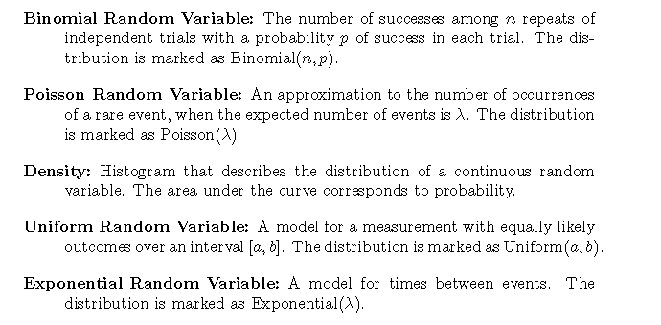
Theoretical Distributions of Observations

Slide 13
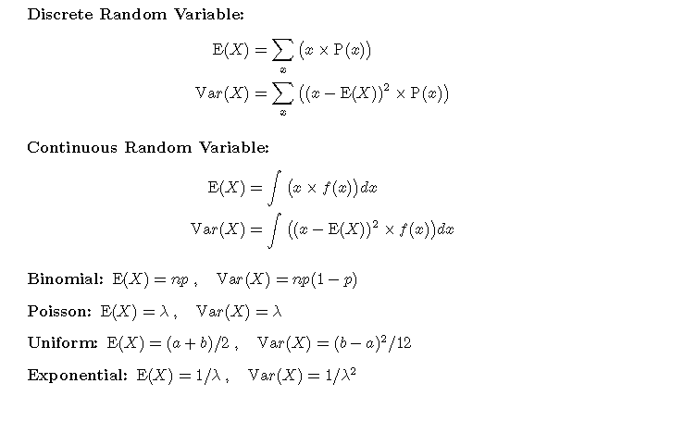
Theoretical Distributions of Observations

Slide 14
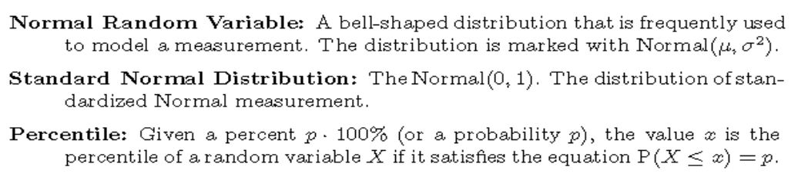
Theoretical Distributions of Observations

Slide 15
Theoretical Distributions of Observations
R functions to be familiar with (you can google to find more help):
Binomial:
The functions “dbinom”, “pbinom”, and “qbinom” may be used in order to compute the probability, the cumulative probability, and the percentiles, respectively, for the Binomial distribution.
The function “rbinom” can be used in order to simulate a random sample from this distribution.
Poisson:
The functions “dpois”, “ppois”, and “qpois” may be used in order to compute the probability, the cumulative probability, and the percentiles, respectively, for the Poisson distribution.
The function “rpois” can be used in order to simulate a random sample from this distribution.

Slide 16
Theoretical Distributions of Observations
R functions to be familiar with (you can google to find more help):
Uniform:
The functions “dunif”, “punif”, and “qunif” may be used in order to compute the density, the cumulative probability, and the percentiles for the Uniform distribution.
The function “runif” can be used in order to simulate a random sample from this distribution.
Exponential:
The functions “dexp”, “pexp”, and “qexp” may be used in order to compute the density, the cumulative probability, and the percentiles, respectively, for the Exponential distribution.
The function “rexp” can be used in order to simulate a random sample from this distribution.

Slide 17
Theoretical Distributions of Observations
R functions to be familiar with (you can google to find more help):
Normal:
The functions “dnorm”, “pnorm”, and “qnorm” may be used in order to compute the density, the cumulative probability, and the percentiles for the Normal distribution.
The function “rnorm” can be used in order to simulate a random sample from this distribution.

Slide 18
Sampling Distribution of Statistics
Theoretical models describe the distribution of a measurement as a function of a parameter, or a small number of parameters.
The general formulation of statistical inference problems involves the identification of a theoretical model for the distribution of the measurements.
This theoretical model is a function of a parameter whose value is unknown.
The goal is to produce statements that refer to this unknown parameter. These statements are based on a sample of observations from the given distribution.
Examples of approaches used in statistical inference to guess the value of the unknown parameter includes:
A guess of the value of the parameter. This approach is point estimation.
An interval which contains the value of the parameter with some subscribed probability. This is the confidence interval approach.
A hypothesis test that the parameter obtains a specific value. This approach is hypothesis testing.

Slide 19
Sampling Distribution of Statistics
Statistics (computed as a function of the measurement) are the vehicles for conducting the statistical inferences.
In the point estimation approach, the statistics used are called estimators.
In the confidence interval approach, the statistics used are called confidence interval.
In the hypothesis testing approach, the statistics used are called test statistics.
The relevant statistic possesses a distribution that it inherits from the sampling distribution of the observations. This distribution is the sampling distribution of the statistic.
The properties of the statistic as a tool for inference are assessed in terms of its sampling distribution.
In order to assess the performance of the statistics we should be able to determine their sampling distribution. There are two approaches to determine the sampling distribution:
One approach is to use a Normal approximation. This approach relies on the Central Limit Theorem.
A second approach is to simulate the distribution. This relies on functions available in R for the simulation of a random sample from a given distribution.

Slide 20
The Normal Approximation
In general, the sampling distribution of a statistic is not the same as the sampling distribution of the measurements from which it is computed.
The most important scenario where the limit distribution of the statistic has a known shape is when the statistic is the sample average or a function of the sample average.
In such a case the Central Limit Theorem may be applied in order to show that, at least for a sample size not too small, the distribution of the statistic is approximately Normal.
The Normal approximation of the distribution of a statistic is valid for cases other than the sample average or functions thereof.
On the other hand, one need not always assume that the distribution of a statistic is necessarily Normal. In many cases it is not, even for a large sample size.

Slide 21
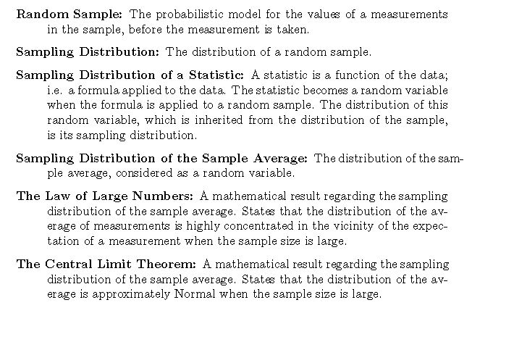
The Normal Approximation

Slide 22

The Normal Approximation

Slide 23
The Normal Approximation
Some addition resources:
https://www.khanacademy.org/math/statistics-probability/sampling-distributions-library/what-is-a-sampling-distribution/v/introduction-to-sampling-distributions (Introduction to sampling distributions)
https://www.khanacademy.org/math/statistics-probability/sampling-distributions-library/sample-means/v/statistics-sample-vs-population-mean (Inferring population mean from sample mean + videos on central limit theorem)

Slide 24
Simulations
https://youtu.be/mt9u0_i_Y8Y (Attention:Note that here when I said Poisson distribution it should have been an Exponential distribution. The book assumes the distribution of price in the car data to be Exponential)
https://youtu.be/X3OBXFaweEA
https://youtu.be/sWTcZxolVPc
https://youtu.be/yBAFF704Y7g
Notes:
A model for the distribution of the observations is assumed each time a simulation is carried out.
The simulation itself involves the generation of random samples from that model for the given sample size and for a given value of the parameter.
The statistic is evaluated and stored for each generated sample.
Thereby, via the generation of many samples, an approximation of the sampling distribution of the statistic is produced.
A probabilistic statement inferred from the Normal approximation can be compared to the results of the simulation.
Substantial disagreement between the Normal approximation and the outcome of the simulations is an evidence that the Normal approximation may not be valid in the specific setting.
Simulations can be used in order to compute the expectation, the standard deviation or any other numerical summary of the sampling distribution of a statistic.
All one needs to do is compute the required summary for the simulated sequence of statistic values and hence obtain an approximation of the required summary.

Slide 25
Self-Quiz Review
# Q1 to Q6: https://youtu.be/hMlNLUUuSaY
# Q7: https://youtu.be/KddAfhfA4E4
# Q8 to Q10: https://youtu.be/JU899f_kW2U

Slide 26
Self-Quiz Review
cars <- read.csv('http://pluto.huji.ac.il/~msby/StatThink/Datasets/cars.csv')
area <- cars$length*cars$width
mean(area)
median(area)
IQR<-quantile(area,c(0.25,0.75))[2]-quantile(area,c(0.25,0.75))[1]
Outlier1<-sum(quantile(area,c(0.25,0.75))[2]+1.5*IQR<area) # 1
Outlier2<-sum(quantile(area,c(0.25,0.75))[1]-1.5*IQR>area) # 0
sum(is.na(area)) # 0

